Slide 1
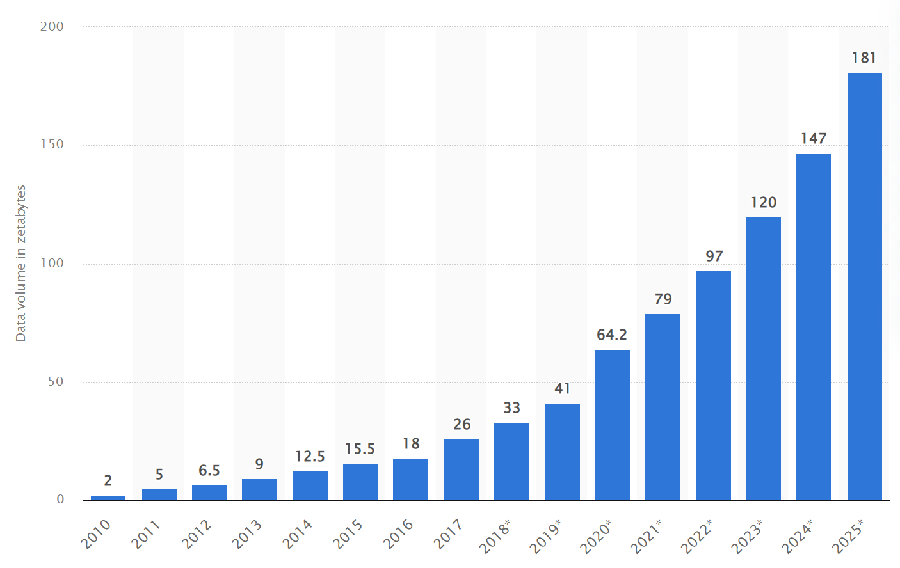

Slide 2
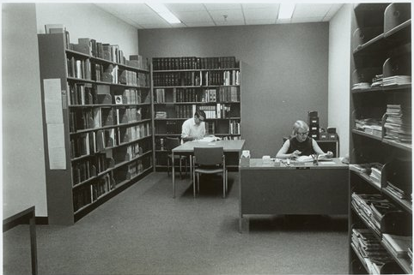
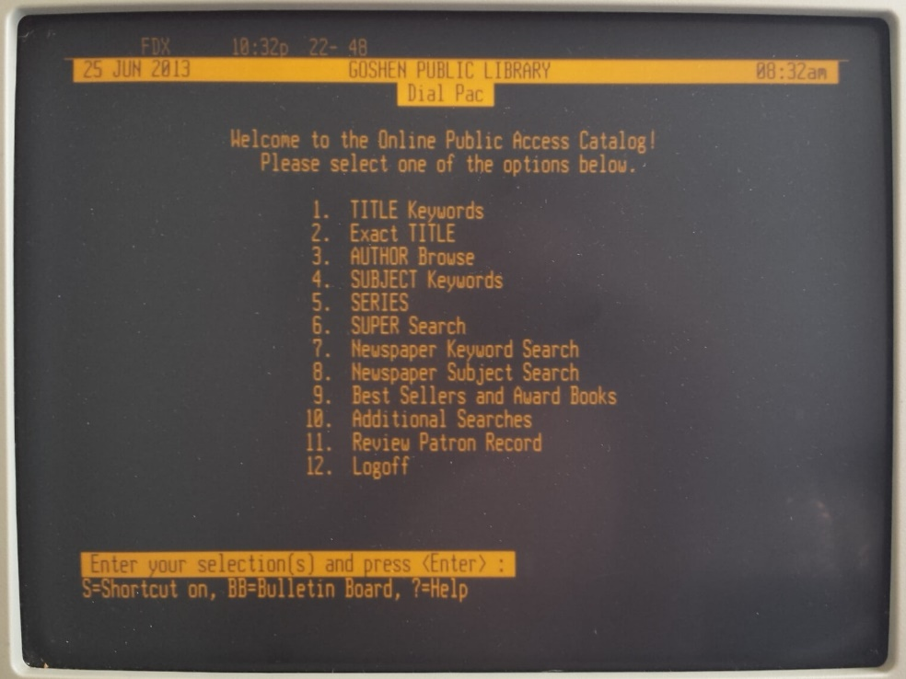

Slide 3
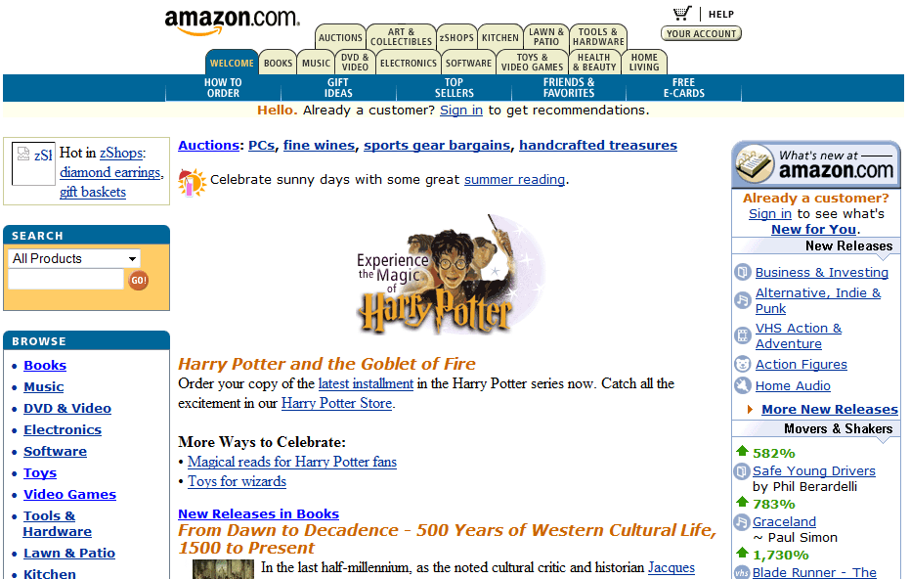
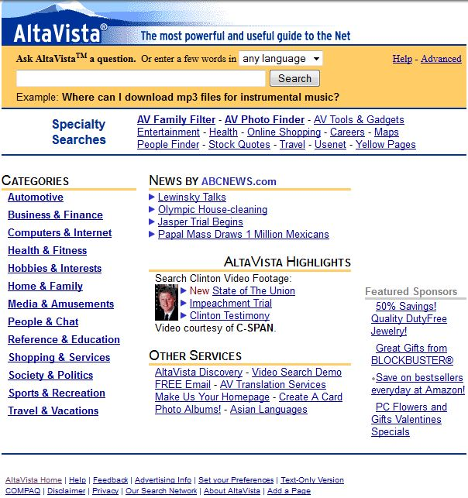

Slide 4
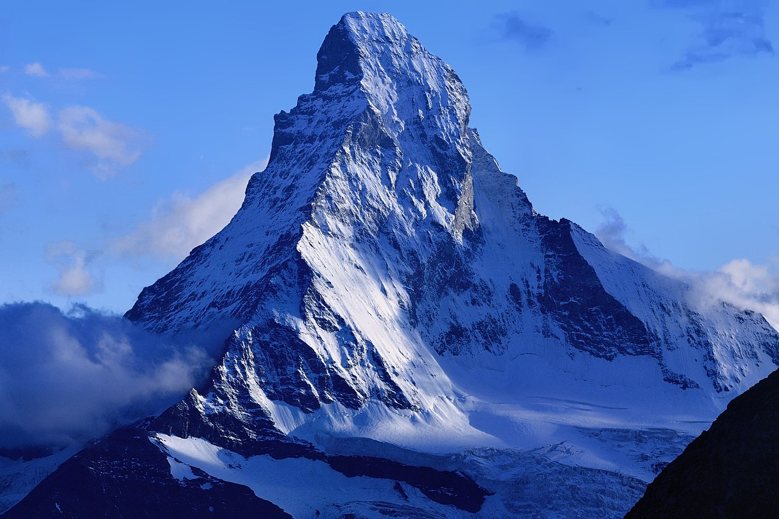
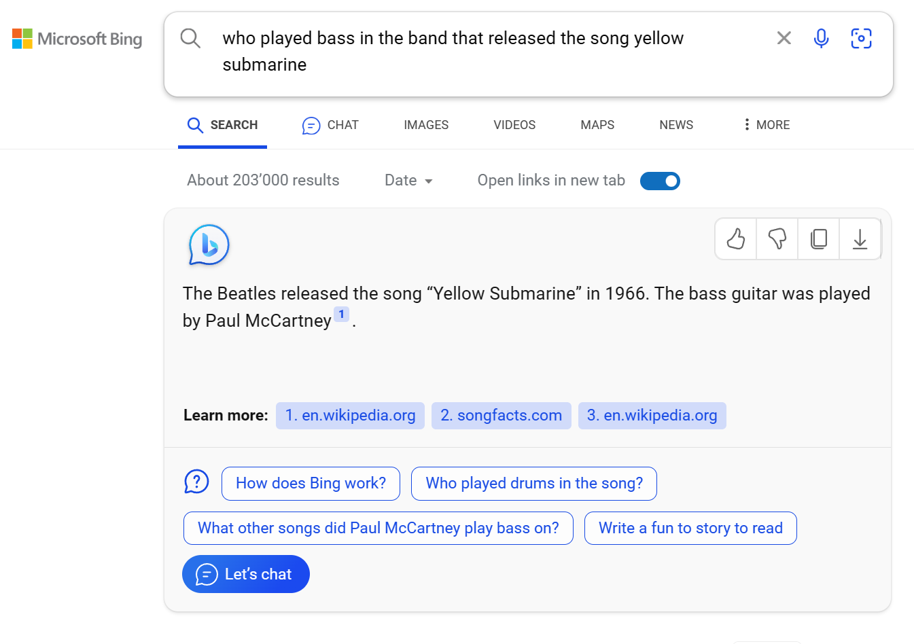
{
"headline": "Majestic Matterhorn Pierces Blue Sky",
"keywords": ["mountain", "peak", "snow", … ],
"named_entities": ["Matterhorn"],
"dominant_colors": ["blue", "white", "gray"],
"dominant_forms_shapes": ["triangle", "pyramid"],
"extracted_text": "",
"people_present": false,
"is_selfie": false,
"is_outdoors": true,
"is_text_image": false
}

Slide 5

10010011001010101010110101101010101010101010101101
picture of a cat
human interpretation
machine interpretation

Slide 6
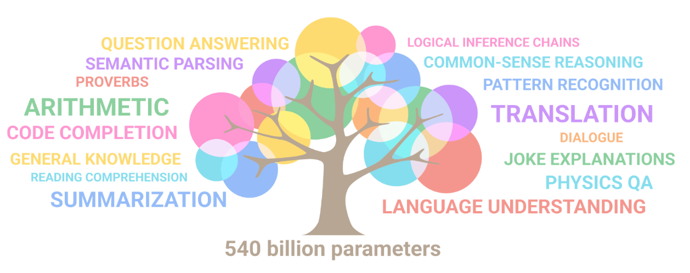
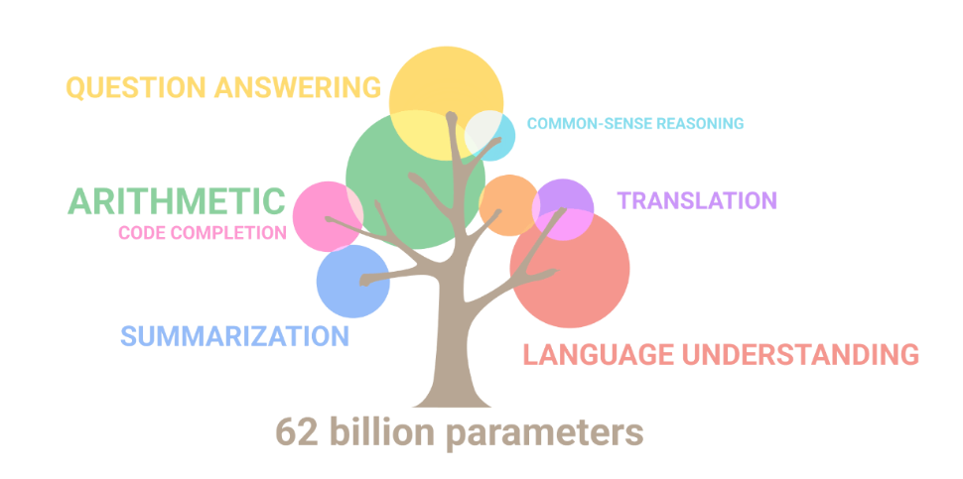
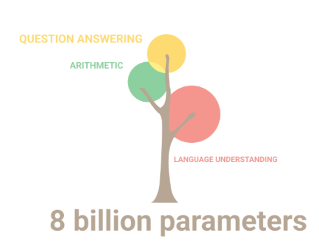

Slide 7
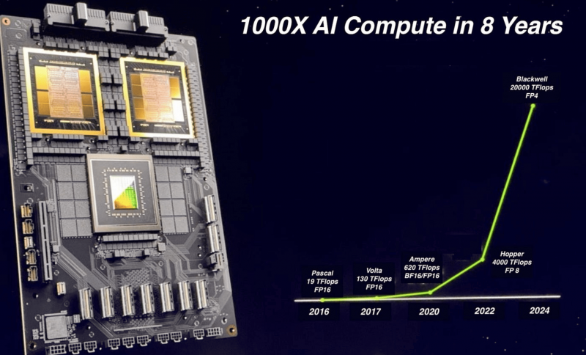
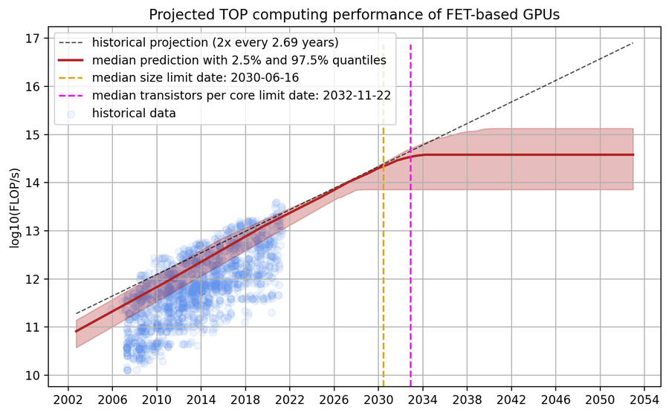

Slide 8
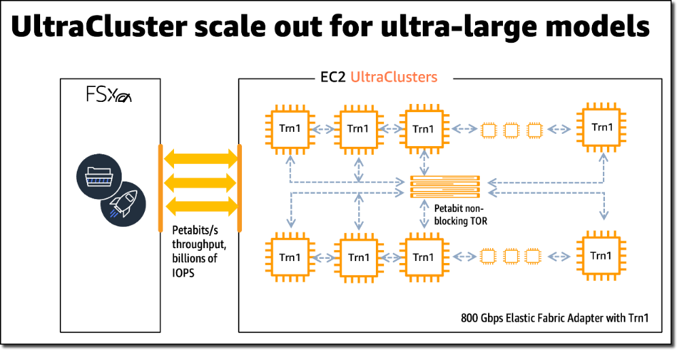

Slide 9
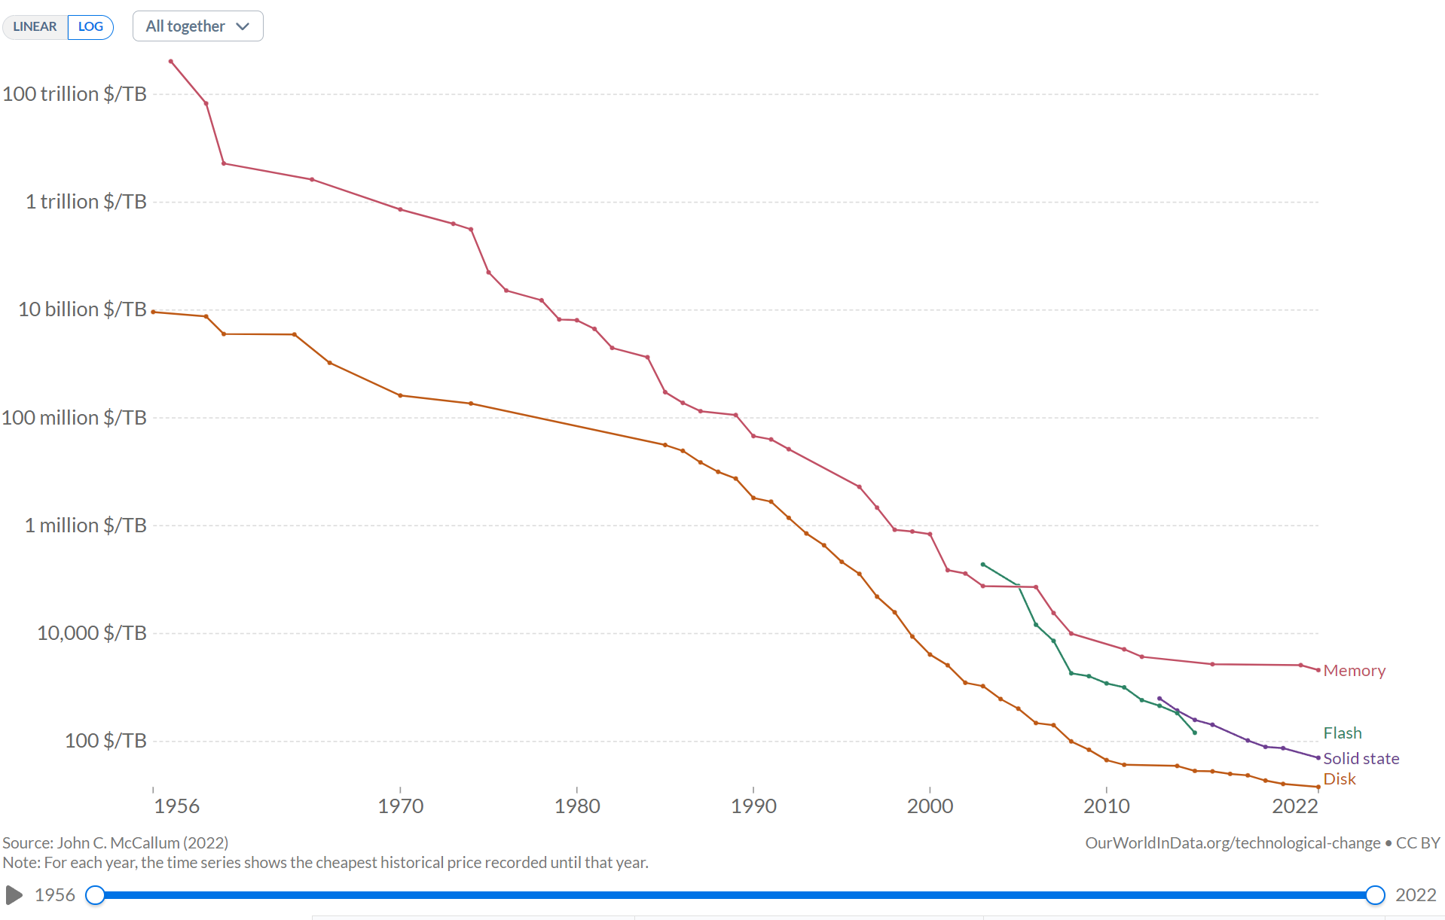
source: https://ourworldindata.org/

Slide 10

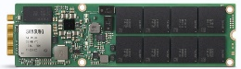
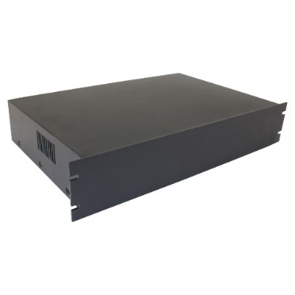
1 Petabyte of storage (2015)
1 Petabyte of storage (2024)
72x 16TB
42U Rack
21x smaller in 3 years
2U Appliance

Slide 11
Device / Channel | GB/s | Time to read | 1 GB | 1 TB | 1 PB | 1 EB | 1 ZB
Hard Disk | 0.2 |  | 5s | 83m | 58d | 158y | 158’000y
Solid State Disk | 0.55 |  | 1.8s | 30m | 21d | 58y | 57’000y
M.2 Flash Drive | 3.5 |  | 0.3s | 5m | 80h | 9y | 9’000y
USB 3.0 | 0.64 |  | 1.6s | 26m | 18d | 50y | 50’000y
PCI-E 2.0 | 4 |  | 0.3s | 4m | 70h | 8y | 7’900y
Ethernet 100GB | 10 |  | 0.1s | 100s | 28h | 3y | 3’200y
Fibre 128GFC | 13 |  | 0.08s | 77s | 22h | 2.5y | 2’400y
DE-CIX | 700 |  | 1.4ms | 1.4s | 24m | 16d | 45y

Slide 12





Offline processing
Online query answering
data sources
metadata
query: best song by “The Beatles”
document analysis
metadata
feature (meta-)data
query parsing & analysis
query refinement & iteration
feature extraction
features
scores & doc ids
retrieval & ranking
ranking & scoring
scores
meta data & docs
result presentation
optimization & scaling
retrieval index

Slide 13
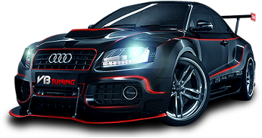
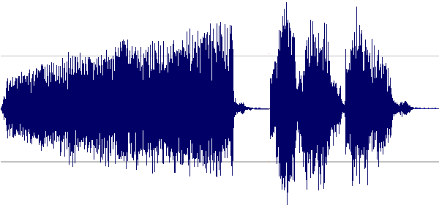

vision
SIFT / HOG
K-Means/ pooling
classifier
car
fixed
unsupervised
supervised
speech
MFCC
Mixture of Gaussians
classifier
\’d e p\
fixed
unsupervised
supervised
NLP
Parse Tree Syntactic
n-grams (of words)
classifier
+
fixed
unsupervised
supervised

Slide 14
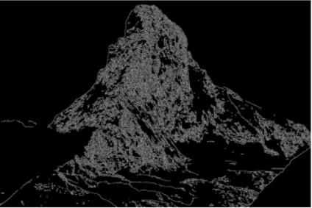
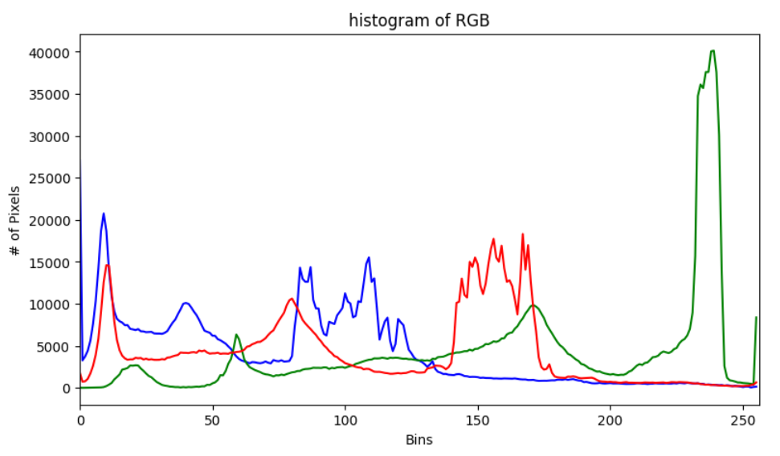
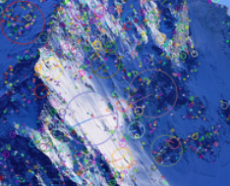
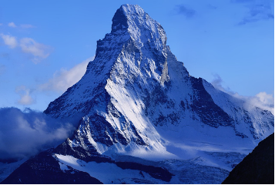
traditional feature engineering
The main subject of this image is a majestic, snow-covered mountain peak, which appears to be the iconic Matterhorn in the Swiss Alps. The mountain dominates the frame, its distinctive pyramid shape rising dramatically against a clear blue sky. The setting is a high-altitude alpine environment, with the peak surrounded by other snow-capped mountains and glaciers visible in the lower portions of the image. The background is primarily composed of a vivid blue sky with a few wispy clouds. The colors in the image are striking, with the brilliant white of the snow contrasting sharply against the deep blue of the sky. The lighting appears to be natural sunlight, creating a play of light and shadow across the mountain's face that accentuates its rugged features and crevices. There are no visible people, animals, or man-made objects in the image. The focus is entirely on the natural grandeur of the mountain. The overall mood of the image is one of awe-inspiring beauty and serene majesty. There's a sense of isolation and pristine wilderness that the mountain embodies. Notable details include the jagged ridgelines of the mountain, the smooth snow fields on its flanks, and the wisps of cloud that cling to its lower slopes, suggesting high winds at the peak. The composition of the image is well- balanced, with the mountain placed slightly off-center, allowing the eye to follow its slopes from base to peak. The surrounding mountains and glaciers …
universal prompt engineering

Slide 15
Retriever
doc 1
doc 2
doc 3
…
query
index

Slide 16
Retriever
Filter & Sort
doc 1
doc 2
doc 3
…
query
index
meta-data
criteria

Slide 17
Retriever
(Filter &) Ranker
doc 1
doc 2
doc 3
…
query
index
rank model

Slide 18
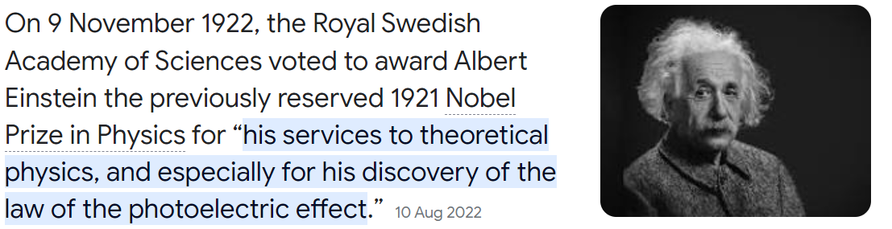
Retriever
Reader
query
index
documents
language model

Slide 19
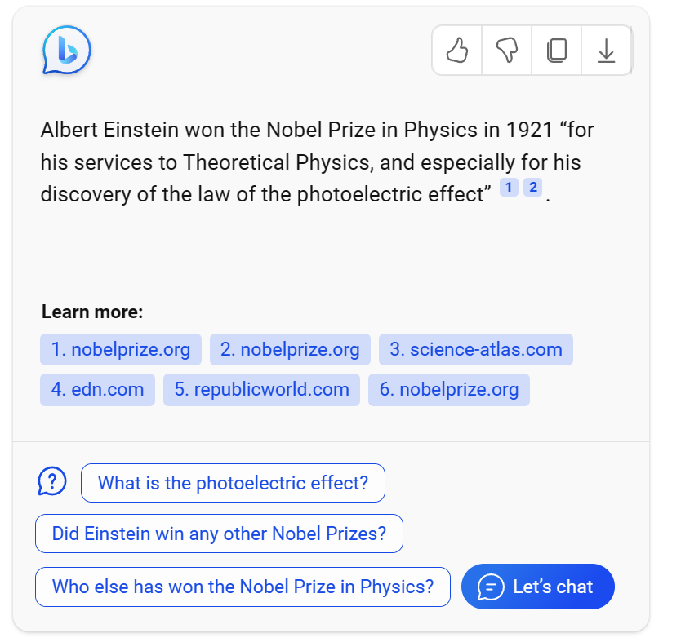
Retriever
Generator
query
index
documents
LLM

Slide 20
Retriever
Reader
query
index
documents
language model

Slide 21
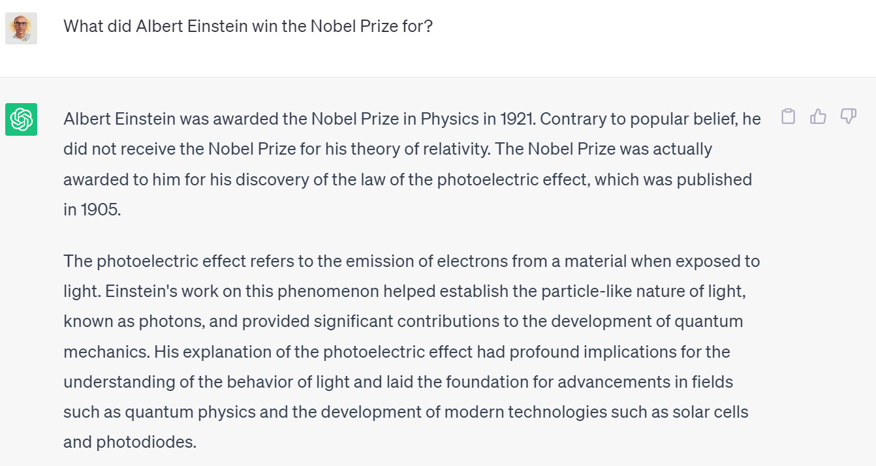
Generator
query
prompt template
LLM
fine-tuning
domain knowledge

Slide 22
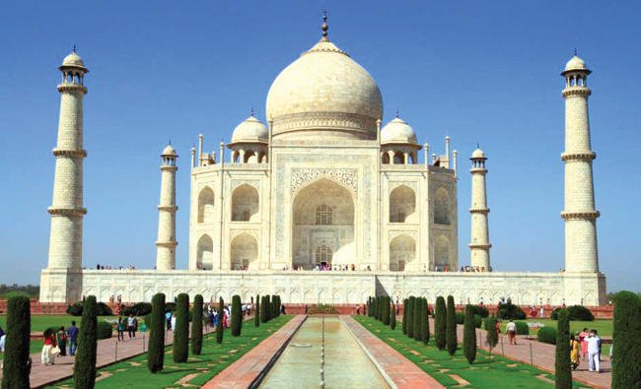
This is what the machine ‘sees’ when trying to understand what Is depicted on the image.
semantic gap
This is what a user may enter to search for such pictures:
building, outdoor, sky, iconic
mausoleum, tomb, dome, minaret
UNESCO World Heritage Site
Taj Mahal, Indian architecture
where is Mumtaz Mahal buried?
Notes:
Question (basic): What is the Taj Mahal?
Solution: Mausoleum, Agra, India, UNESCO World Heritage Site
Question (basic): What is metadata?
Solution: Additional information, context, descriptions, annotations
Question (intermediate): What are the two main methods for obtaining metadata for images?
Solution: Manual annotations and automated annotations
Question (intermediate): What are the challenges associated with obtaining metadata for images?
Solution: Differences in semantic levels, subjective and abstract concepts, variations in level of detail, choice of keywords, depth of domain knowledge
Question (intermediate): What are the different types of metadata that can be associated with an image?
Solution: Generic, specific, and abstract metadata
Question (advanced): What are some examples of community-maintained databases that hold records for movies and music?
Solution: IMDb and MusicBrainz
Question (advanced): What are the challenges associated with annotating arbitrary photos and videos?
Solution: The absence of a curated reference database, the high costs associated with annotating every single photo and video
Question (advanced): What are the "seven insurmountable obstacles" to achieving a meta-utopia, as highlighted by Cory Doctorow?
Solution: People lie, people are lazy, people are stupid, mission impossible, know thyself, schemas aren't neutral, metrics influence results, more than one way to describe it
Question (expert): What are the different semantic levels at which metadata can be extracted from images?
Solution: Perception level and recognition level
Question (expert): What are the challenges associated with modern web-based metadata extraction, and how can they be addressed?
Solution: The direct neighborhood within the HTML is less reliable due to advanced scripts and CSS styles; visual proximity between embedded objects and text blocks can be used to describe the context of the embedded object.

Slide 23
Object Facet | Value
Generic Object Instance | building, water, sky
Generic Object Class | mausoleum, tomb, dome, minaret
Specific Named Object Class | UNESCO World Heritage Site (since 1983)
Specific Named Object Instance | Taj Mahal
Spatial Facet | Value
Generic Location | outside
Specific Location Hierarchy | India, Uttar Pradesh, Agra
Event / Activity Facet | Value
Generic Event/Activity | tourism, attraction
Specific Event Instance | International World Heritage Expert Meeting on Visual Integrity in 2006
Contextual Facet | Value
Topic | Indian Architecture
Related Concepts / Objects | Shah Jehan, Mumtaz Mahal, Islam
Abstract Concept | love, death, devotion, remembrance
Context | built in memory of his favorite wife Mumtaz Mahal, by Shah Jehan; completed 1648
Temporal Facet | Value
Generic Time | summer, daytime
Specific Time | 2006 (photo taken)

Slide 24
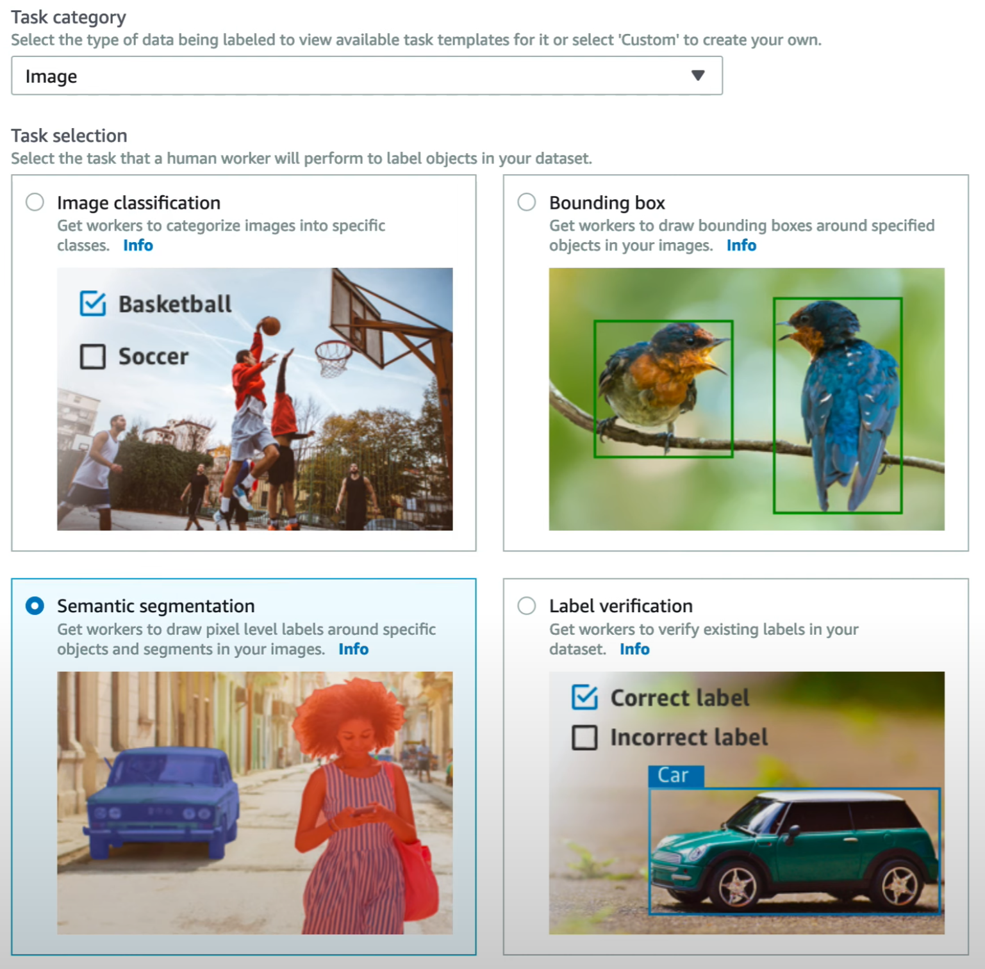


Slide 25
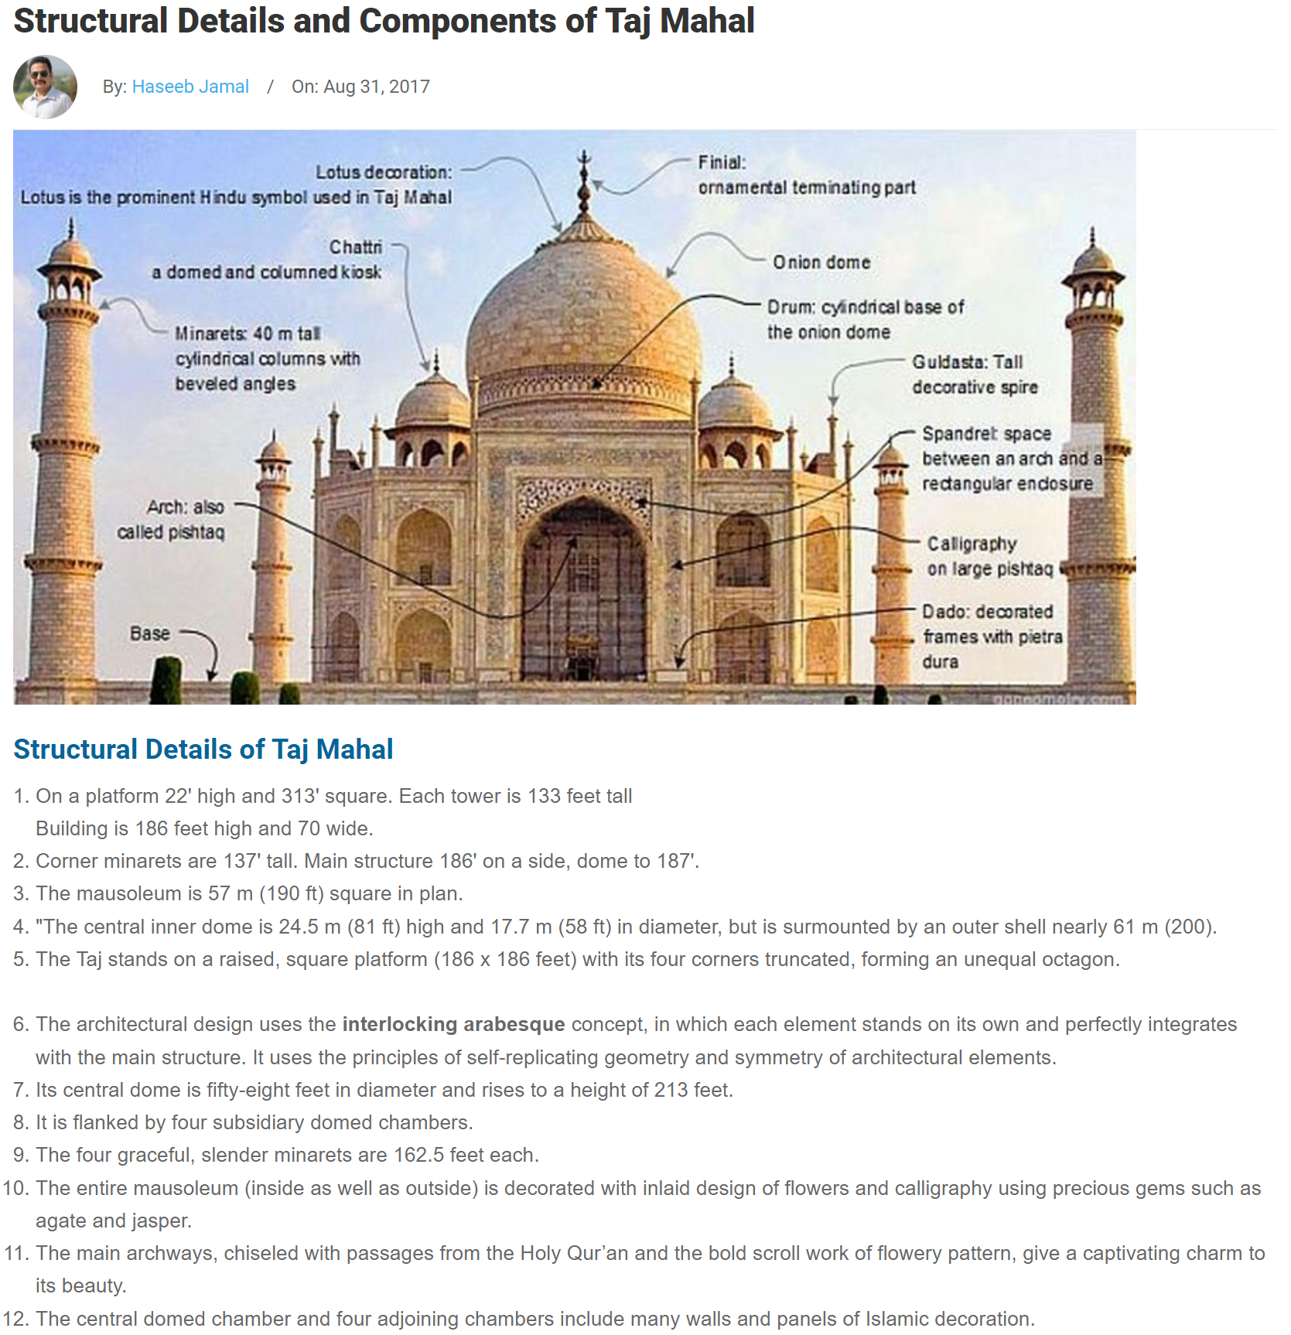
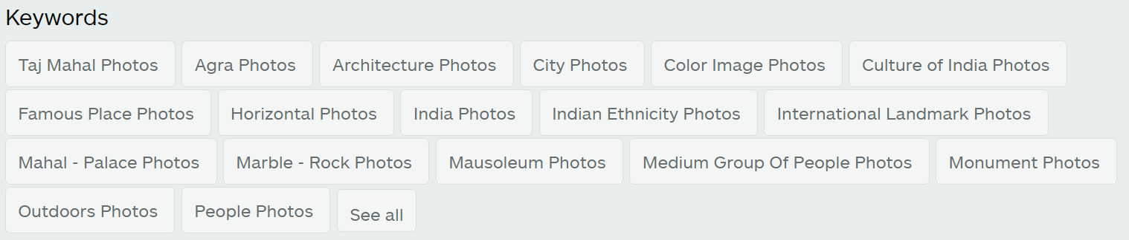

Slide 26

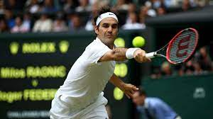
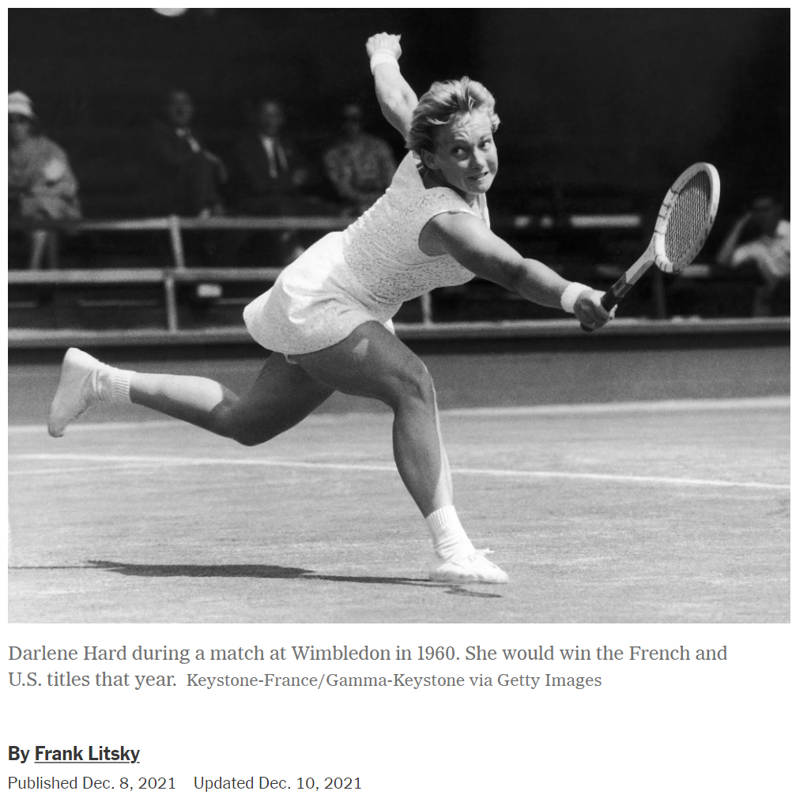

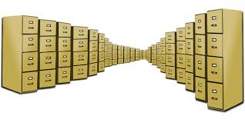
Roger Federer
need a picture of Darlene Hard for an obituary in the New York Times
John McEnroe
nice shot of Roger Federer
Darlene Hard
not yet famous

Slide 27
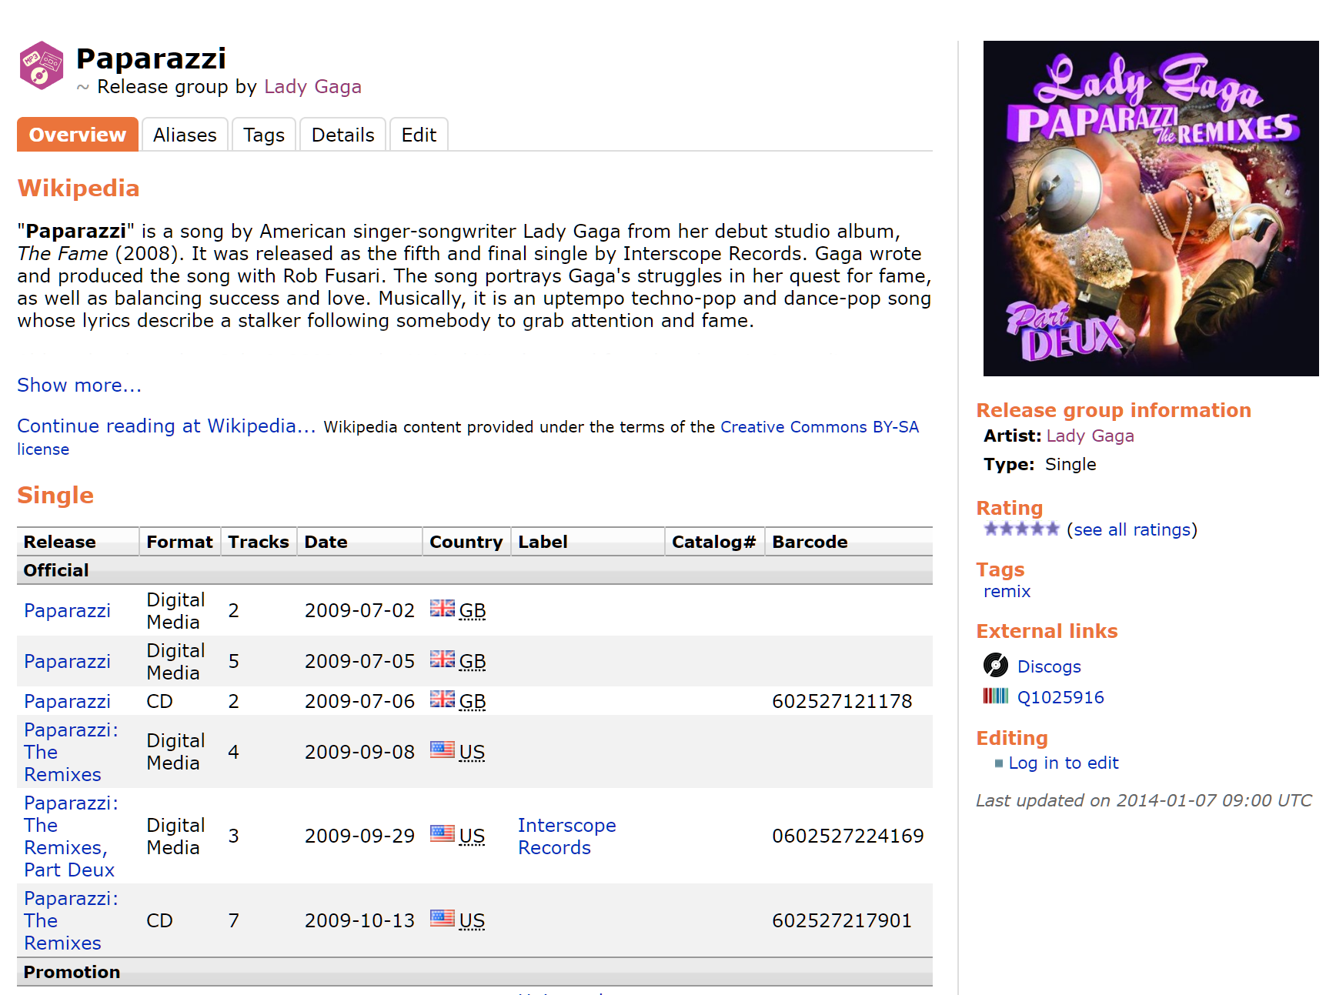
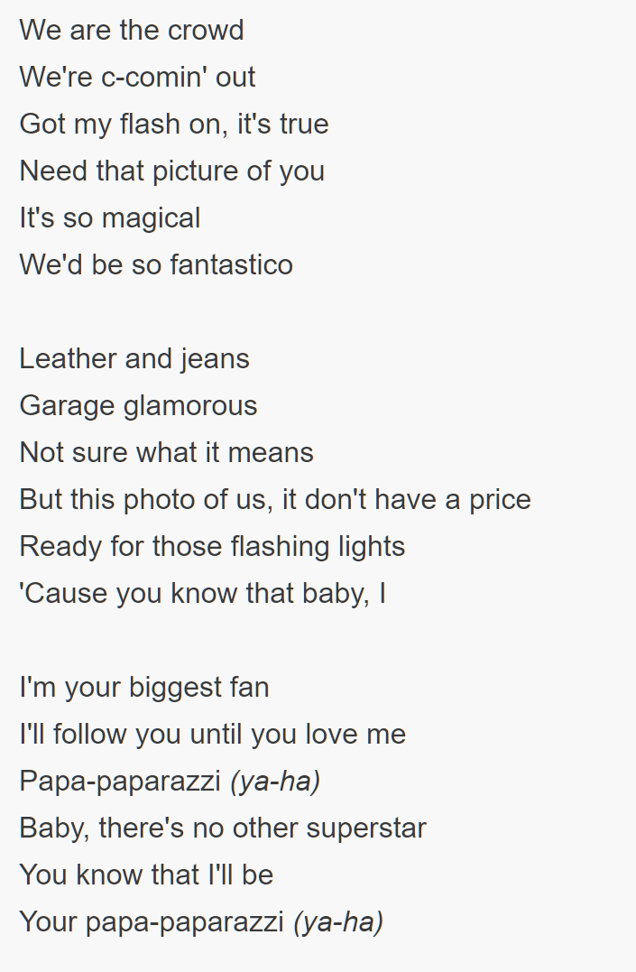
lyrics

Slide 28
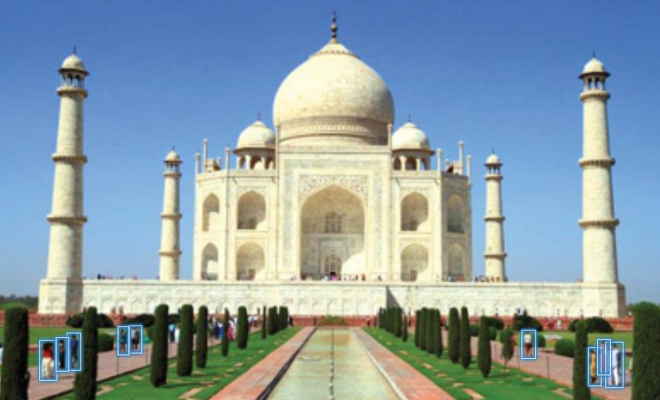
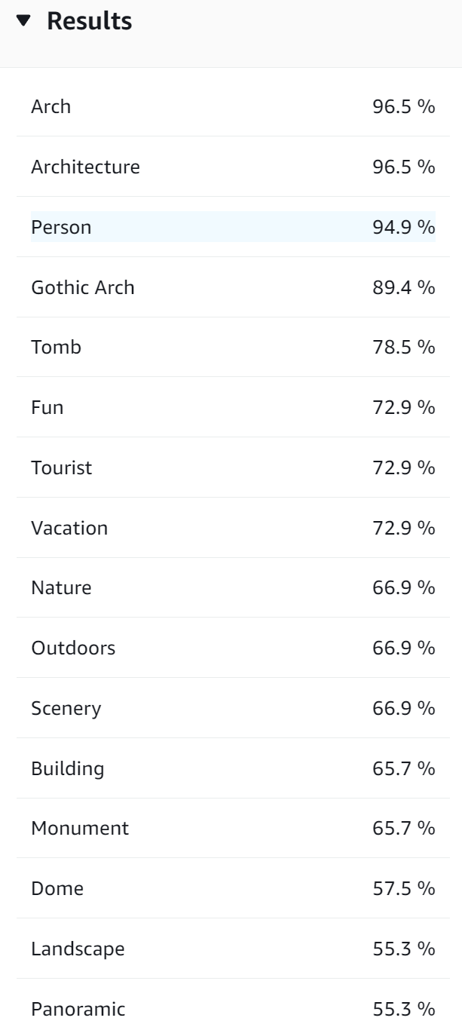
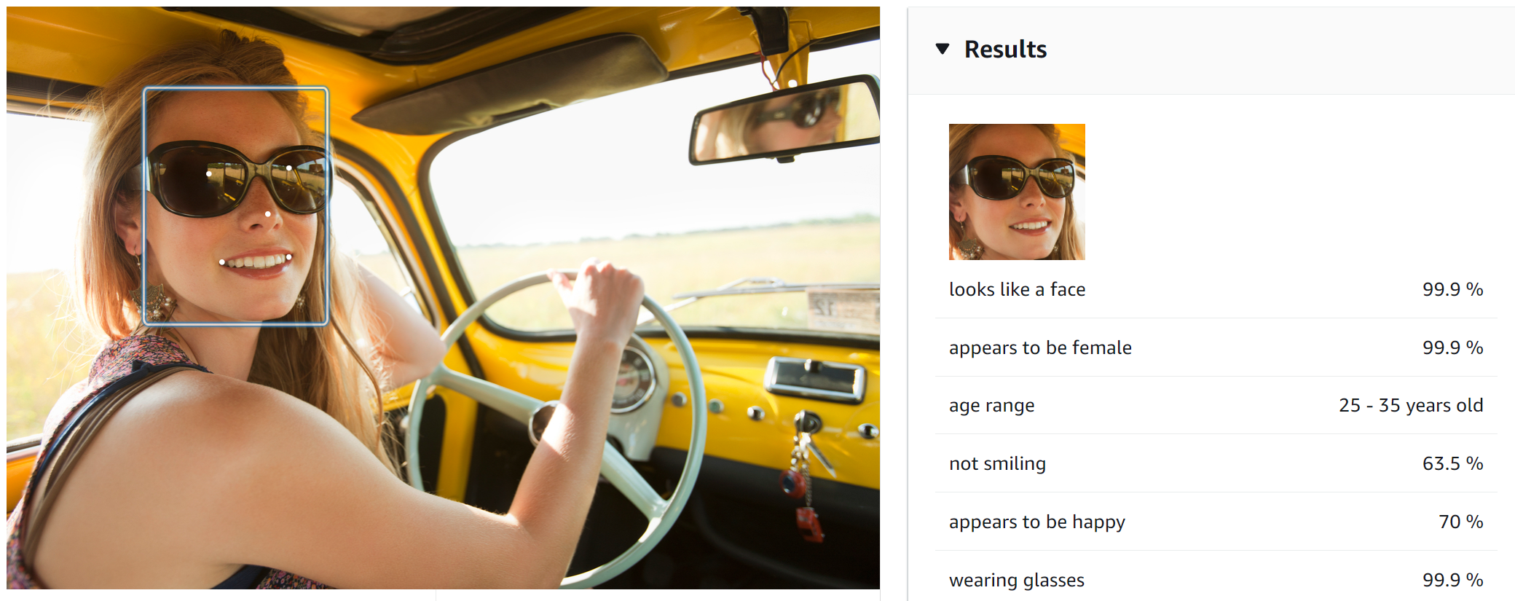
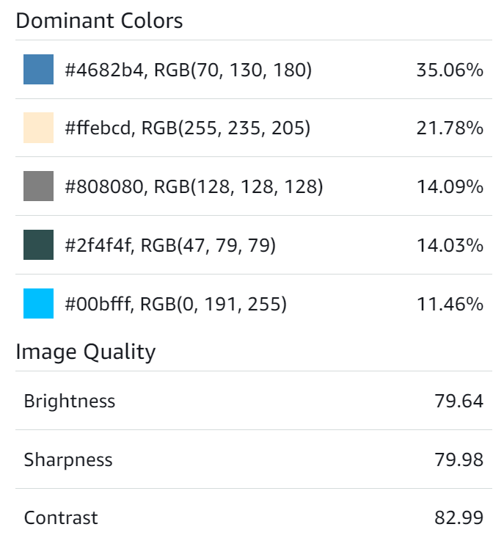
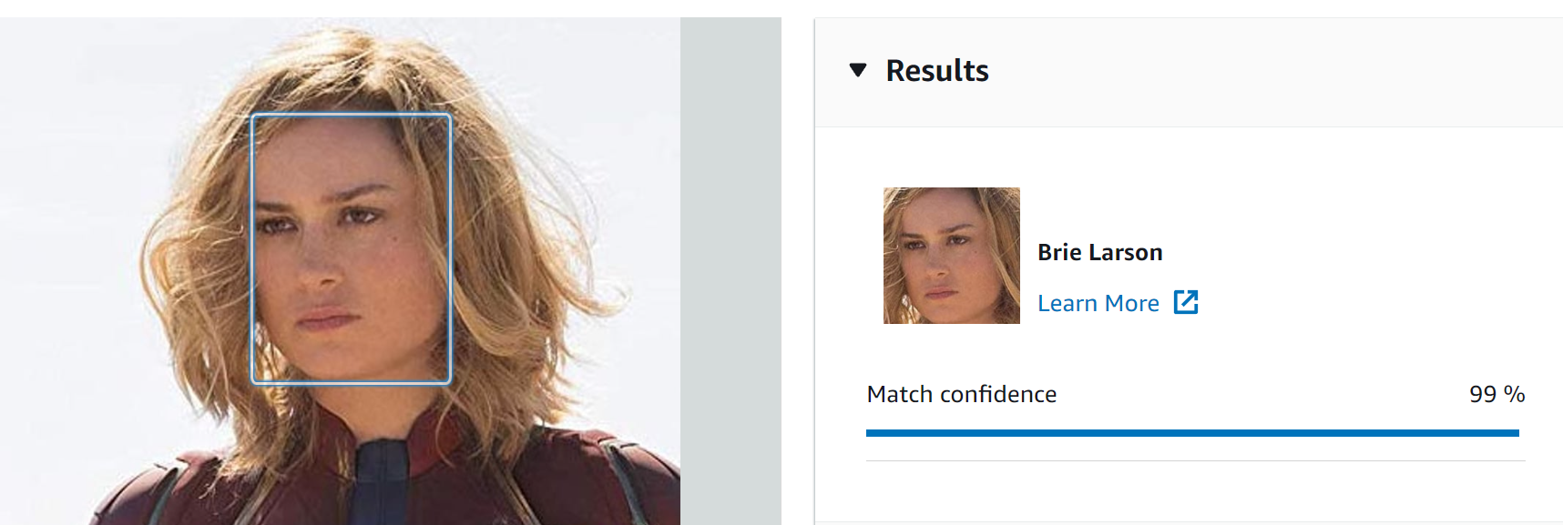
recognition
perception

Slide 29
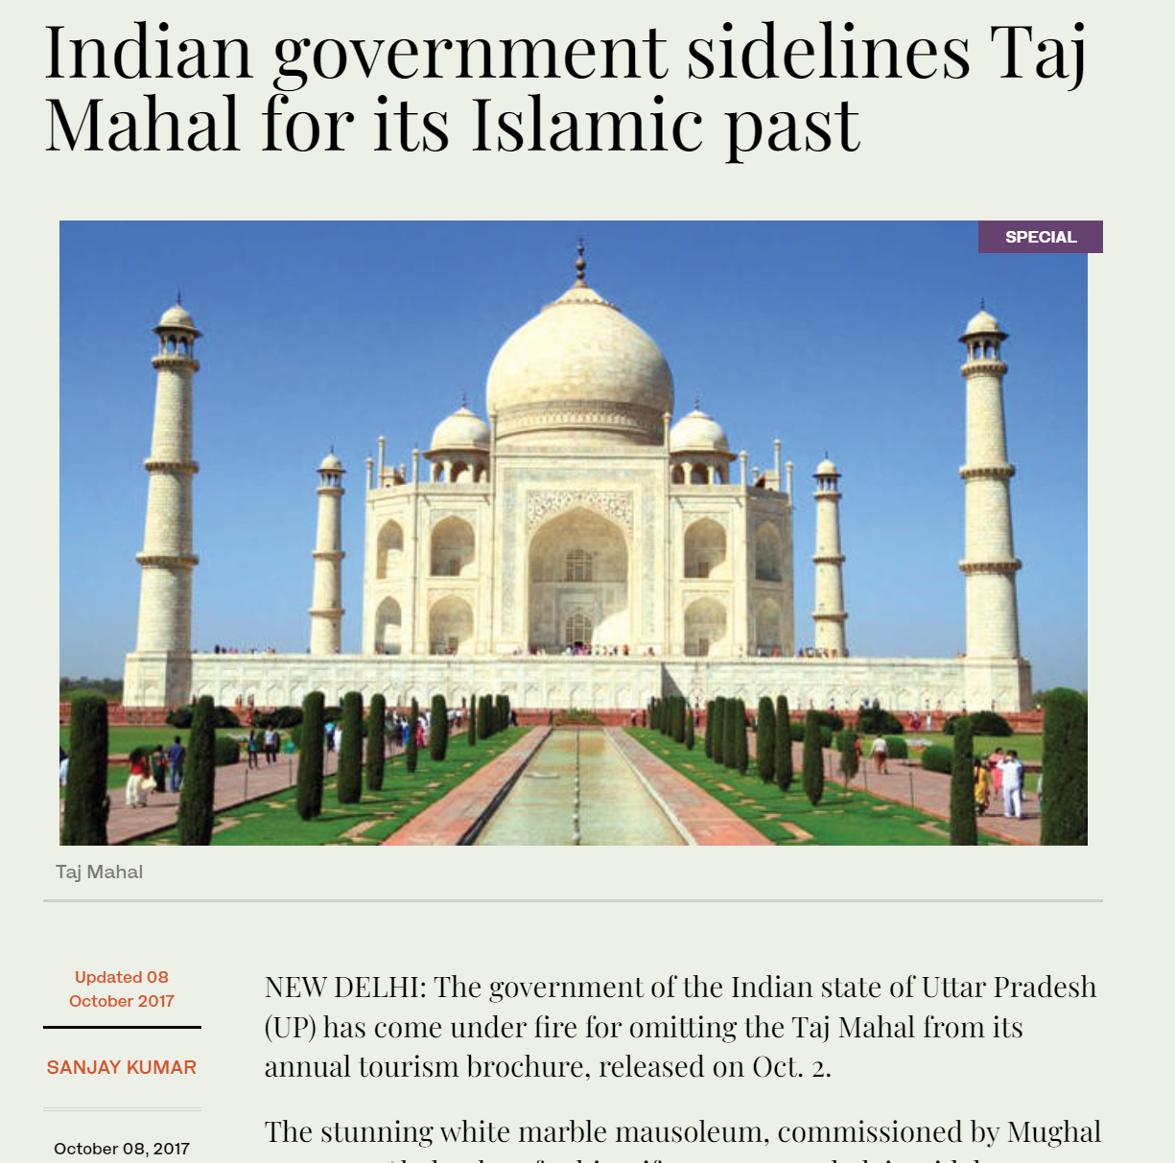
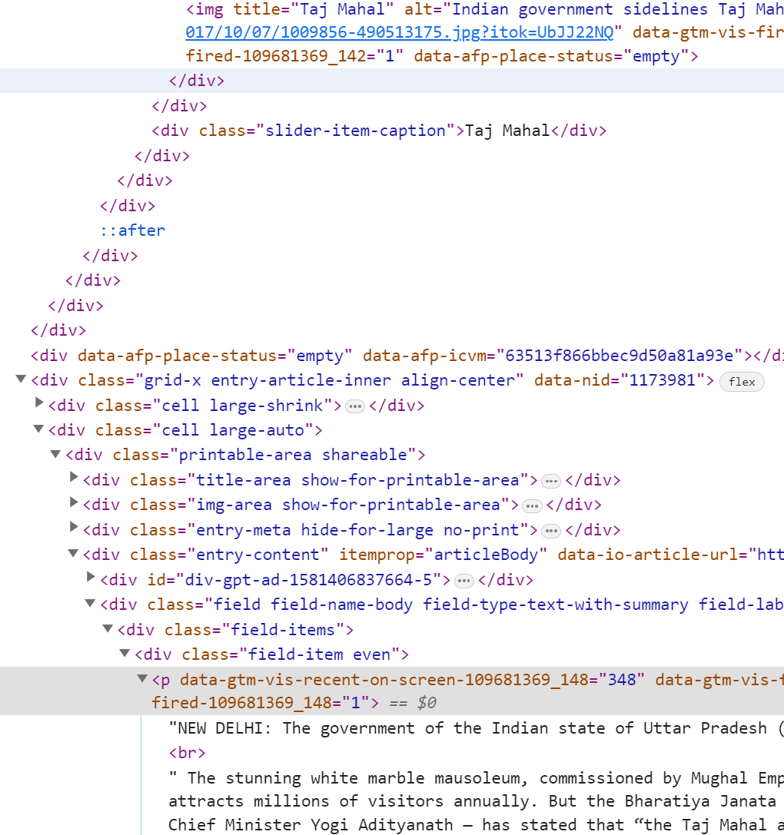
Taj Mahal

Slide 30
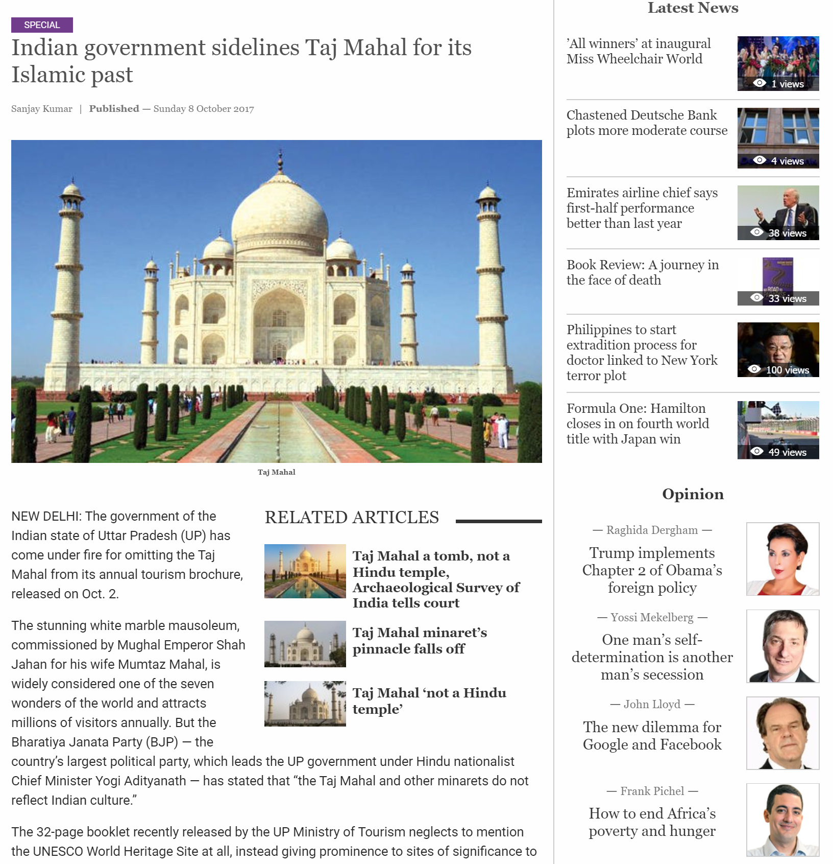
Contains many of the keywords as we discussed earlier in this chapter
Visual boundary between the two columns

Slide 31
The main subject of this image is a majestic, snow-covered mountain peak, which appears to be the iconic Matterhorn in the Swiss Alps. The mountain dominates the frame, its distinctive pyramid shape rising dramatically against a clear blue sky. The setting is a high-altitude alpine environment, with the peak surrounded by other snow-capped mountains and glaciers visible in the lower portions of the image. The background is primarily composed of a vivid blue sky with a few wispy clouds. The colors in the image are striking, with the brilliant white of the snow contrasting sharply against the deep blue of the sky. The lighting appears to be natural sunlight, creating a play …
Prompt: Please provide a detailed description of the image you see. Include information about: - The main subject or focus of the image - The setting or background - Colors and lighting
- ...
{
"headline": "Majestic Matterhorn Pierces Blue Sky",
"keywords": ["mountain", "peak", "snow", … ],
"named_entities": ["Matterhorn"],
"dominant_colors": ["blue", "white", "gray"],
"dominant_forms_shapes": ["triangle", "pyramid"],
"extracted_text": "",
"people_present": false,
"is_selfie": false,
"is_outdoors": true,
"is_text_image": false
}
Prompt: Analyze the given image and provide a JSON output with the following information:
{...definition omitted here...} Please ensure that: 1) The "headline" is concise and accurately represents the image's main subject, 2) "keywords" include relevant terms describing the ...
Notes:
Note: to produce even better prompts, you can use so-called meta-prompts that generate the prompt based on your basic specifications.

Slide 32
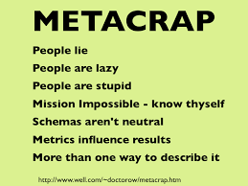
Notes:
a language model is a probabilistic model that generates the most likely output given the input using a non-deterministic, trained selection method for the next token. The model will always try to produce an output whether it is correct or not, it cannot easily assess.

